Slide 1
Health mapping project update
Nesta Innovation Mapping team
April 2018

Slide 2
Structure
Recap
Conceptual framework
Data audits and pilot development
Use cases & personas
Plan for June meeting
Next steps

Slide 3
Recap: Goals
We will build a Health Innovation Scanner - a database and search and mapping tool hosted on a public website that allows its users - including policymakers, health and care decision-makers , investors, funders, innovators and the public - to explore the latest health innovations across the world, and map where innovators are working together to amplify their impact.

Slide 4
Recap: Stage
Scoping
Exploring
Scaling
Conceptual framework
What are we measuring?
Data audits
What data do we use?
How do we collect it and analyse it ?
Use cases / personas
How do we present the data to support decisions
We are here

Slide 5
Conceptual framework: What do we mean by Health Innovation?
New approaches that enable individuals and communities to take more control of their health, generate and make use of new sources of data and/or digital technologies, or improve how health and care is made available and delivered. These innovations should lead to fairer and more equitable health outcomes.
Novelty: We need to identify new ideas
Means: We have priors about some of the technologies / strategies being used by Health Innovators: Digital / data / social innovation and people-powered approaches (e.g. peer support)
Users / Purposes: These new ideas are developed by specific actors and play particular roles in formal/informal health systems.

Slide 6
Data framework: Key ideas
We are running a set of pilots to measure health innovations in different data sources.
We are going from the known to the unknown.
By mapping the known we create a baseline
Two methods provide the foundation for our analysis:
Network science: We expand from existing networks to identify new actors
Natural language processing: We transform text into data
We identify gaps through interaction with stakeholders and address them by incorporating new data into the analysis

Slide 7
Implementation
Health Innovation
What health innovations are being funded already? In what domains? To address what needs?
(Labelled, filtered, known)
What is happening in the network / ‘neighbourhood’ of known health innovators?
(Expands from the initial ‘seed’ into the unknown)
What is happening in other platforms and sites being where we would expect to see health innovation
(targets specific areas of interest, fills gap in the above)

Slide 8
Pilot 1a: Funding landscape for Health innovation in the USA / UK / EU
Funding data
Health innovations
RWJF open / web data / Pioneers / Global (~25K projects with dates, amounts, organisations, topics, links)
Agency for Healthcare Research and Quality (AHRQ)
Grants.gov
UK Gateway to Research (UK research funding)
Innovate UK
EU Horizon 2020 projects
360 Giving (NGO activity in UK, includes Nesta)
Research.gov, Federal RePORT Expenditures and Results, Tracking Accountability in Government Grants System (TAGGS), US Environmental Protection Agency
We have developed Namor, an information retrieval tool which allows us to identify documents and rank in specific topics within a ‘corpus’.
We can use funding metadata to identify locations, amounts, times...

Slide 9
Progress in data collection and analysis
We currently have ~128K records including highly relevant data sources (RWJF) and others that have to be queried to find innovation-related projects.
An initial analysis of the funding data we have collected leads us to identify 39K grants related to health, with a value of $215 Bn. Now we will look for Health Innovations in there:
Projects that use innovative technologies.
An initial exploration reveals 752 health projects using ML, 543 Robotics, 200 using VR and 140 using Blockchain.
Projects that are similar to those supported by RWJF/Nesta innovation programmes
Projects that are very different from the rest or in new topics not mentioned before.

Slide 10
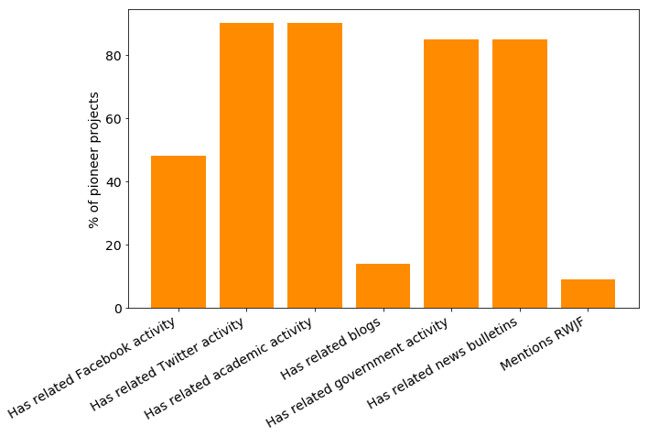
Pilot 1b: Expanding from the current funding landscape to related health innovation landscapes
Health innovations (known)
Health innovations (expanded)
We are developing a ‘network’ expansion system that uses Google Search API and academic databases to identify connections and collaborators of currently funded projects. We are piloting this with the Pioneers list.

Slide 11

Pilots 2-4: Use other datasets to map health innovations
GitHub, crowdfunding sites, Twitter, open science sites, start-up sites...
Health innovations
Use Namor and other NLP methods to identify health innovations of interest
An initial exploration of 3,6 million EU projects in GitHub, an open source repository, reveals 2,000 projects on Health, including 40 using ML/AI methods. Examples:
Augmented Reality for Application on Medical field library.
Deep learning code for various data analytics tasks at university hospital Dresden.
There are many different platforms we could look at: selection based on your / Nesta interest, and gaps identified in stakeholder interviews. Current candidates include AI and peer-support groups

Slide 12
Pilot 5... from data to meaning (and action!)?
Gaps and opportunities
(Projects, topics and places)
Innovation...
Funding
...Activity
Programme gaps / policy implications / new stakeholder engagement strategies
Societal need
Health care data
Policy debates
Social media...
Pilot 5?

Slide 13
Use cases and personas
Goal: To ensure the Scanner is relevant and useful to a wide variety of end users (e.g. RWJF, Nesta, funders, policymakers, innovators)
Desk research
Refined use cases
Impact measurement
Proposal/ Inception report: Possible end users & use cases
Group & 1-to-1 interviews
Personas
Informed pilot design
Challenges with current data; ‘pain points’
Ideal experience using the Scanner
Key features needed (timeliness, robustness, etc.)

Slide 14
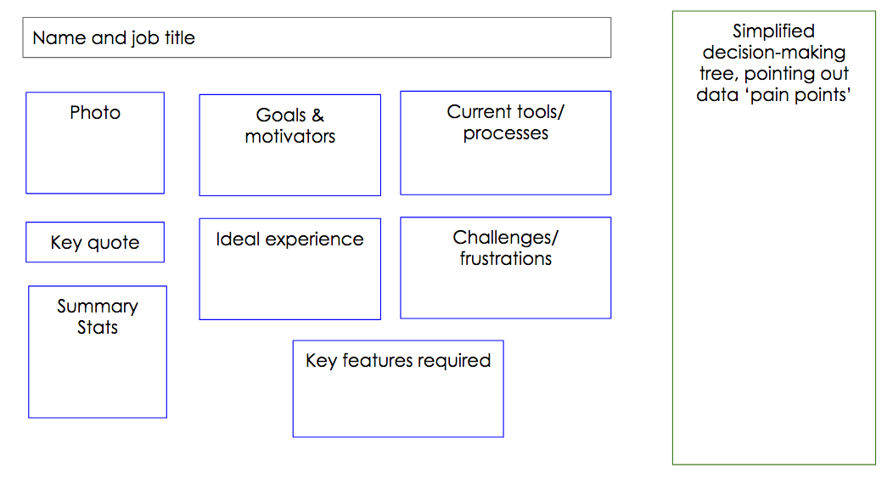
Personas - a template

Slide 15
Use cases/questions - preliminary ideas
Health policymaker | What health innovations should we support and implement on a larger scale? Are there trends in health innovation that will require new regulatory frameworks?
Public research funder (e.g. ESRC) | What are the most promising research areas? What opportunities for collaboration exist across health researchers in different domains?
Experts/ academics | How can we further understand the health innovation system? What are the trends? Which questions require further exploration?
Health innovator | Where do I find resources to help develop my ideas?
Interviews and group discussions in coming weeks will provide additional insight into questions and ‘pain points’ of potential end users of the Scanner

Slide 16
Plan for June meeting
Half-day visit - Monday June 11, 9:30am - 12:30pm
What questions will the Scanner address?
Present pilots (1.5 hours presentation)
Goal: obtain feedback on pilots, explore use cases, discuss which pilots would be most valuable to scale up
Attendees: RWJF, Nesta, 3-4 other external stakeholders (TBD)
What methods are we using to develop the Scanner?
Present data science for health mapping masterclass (1.5-hr workshop)
Goal: Present methods and data sources used in the pilots
Attendees: RWJF, Nesta, other external stakeholders with relevant technical expertise/interests (TBD)

Slide 17
Next steps
April |  |  |  | May |  |  |  | June
W1 | W2 | W3 | W4 | W1 | W2 | W3 | W4 | W1 | W2 | W3 | W4
Pilot 1
Pilot 2 (AI?)
Pilot 3 (peer-support?)
Pilot 5 (Societal needs?)
Pilot 4 (TBC)
Stakeholder interviews and validation

